Slide 1

JavaScript Chapter 07: Classes

Slide 2
Introduction
In this chapter, we are going to discuss JavaScript classes. We have seen JavaScript objects already, and classes are a blueprint or template for object creation. So, many of the things discussed here should not sound too unfamiliar or revolutionary.
Classes enable object-oriented programming, which was one of the most important design advancements in software development. This development reduced the complexity of applications and increased maintainability by a huge margin.

Slide 3
Introduction
So, object-oriented programming and classes are of great importance for computer science in general. This is not necessarily the case when we apply it to JavaScript though. JavaScript classes are something special compared to other programming languages. Beneath the surface, classes are wrapped in some sort of special function. This means that they are actually an alternative syntax for defining objects using a constructor function. In this chapter, we will learn what classes are and how we can create and use them. Along the way, we will cover the following topics:
Object-oriented programming
Classes and objects
Classes
Inheritance
Prototypes

Slide 4
Object-oriented programming
Before we start diving right into the fun of classes, let's briefly say something about object-oriented programming (OOP). OOP is a very important programming paradigm wherein code is structured in objects, leading to more maintainable and reusable code. Working with OOP teaches you to really try to think of all sorts of topics in objects, by bundling properties in such a way that they can be wrapped in a blueprint called a class. This in turn might be inheriting properties from a parent class.
For example, if we are thinking of an animal, we can come up with certain properties: name, weight, height, maximum speed, colors, and a lot more. And then if we think of a specific species of fish, we can reuse all the properties of "animal" and add a few fish-specific properties in there as well. The same for dogs; if we then think of a dog, we can reuse all the properties of "animal" and add a few dog-specific ones to it. This way we have reusable code of our animal class. And when we realize we forgot a very important property for the many animals in our application, we only need to add it to the animal class.
This is very important for Java, .NET, and other classic object-oriented ways of writing code. JavaScript doesn't necessarily revolve around objects. We will need them and we will use them, but they are not the star of our code, so to speak.

Slide 5
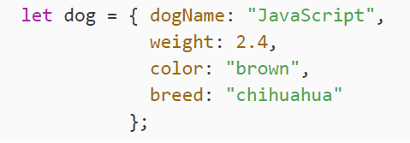
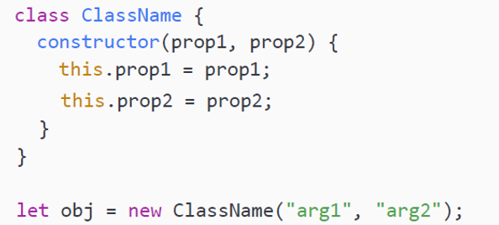
Classes and objects
As a quick refresher, objects are a collection of properties and methods. We saw them in Chapter 3, JavaScript Multiple Values. The properties of an object should have sensible names. So for example, if we have a person object, this object could have properties called age and lastName that contain values. Here is an example of an object:
Classes in JavaScript encapsulate data and functions that are part of that class. If you create a class, you can later create objects using that class using the following syntax:

Slide 6
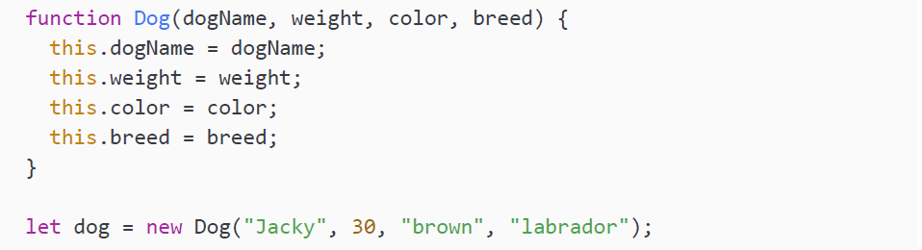
Classes and objects
This code defines a class with ClassName as a name, declares an obj variable, and initializes this with a new instance of the object. Two arguments are provided. These arguments will be used by the constructor to initialize the properties. As you can see, the parameters of the constructor and the properties of the class (prop1 and prop2) have the same name. The properties of the class can be recognized by the this keyword in front of them. The this keyword refers to the object it belongs to, so it is the first property of the instance of ClassName.
Remember we said that classes are just some special function beneath the surface. We could create the object with a special function like this:

Slide 7
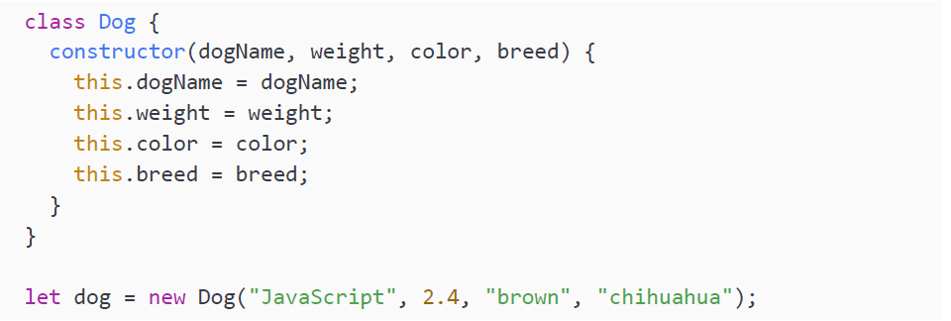
Classes and objects
The dog example could have been made using a class syntax as well. It would have looked like this

Slide 8
Classes and objects
This results in an object with the same properties. If we do some logging as follows, we will be able to see it:
This will output:
In the next section, we will dive into all the parts of classes.

Slide 9
Classes
You may wonder, if classes do the exact same thing as simply defining an object,
why do we even need classes? The answer is that classes are essentially blueprints
for object creation. This means that we need to do much less typing if we need
to create 20 dogs when we have a dog class. If we have to create the objects, we
will have to specify all the properties' names each time. And it would be easy to
make a typo and misspell a property name. Classes come in handy in these sorts
of situations.
As shown in the previous section, we use the class keyword to tell JavaScript we
want to create a class. Next, we give the class a name. It is the convention to start
class names with a capital letter.
Let's have a look at all the different elements of a class.

Slide 10
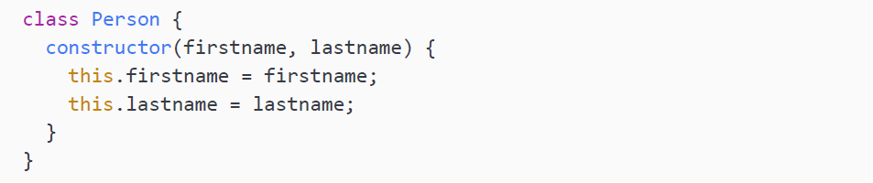
Constructors
The constructor method is a special method that we use to initialize objects with our class blueprint. There can only be one constructor in a class. This constructor contains properties that will be set when initiating the class.
Here you can see an example of a constructor in a Person class:

Slide 11
Constructors
Beneath the surface, JavaScript creates a special function based on this constructor. This function gets the class name, and it will create an object with the given properties. With this special function, you can create instances (objects) of the class.
Here is how you can create a new object from the Person class:
The new word is what tells JavaScript to look for the special constructor function in the Person class and create a new object. The constructor gets called and returns an instance of the person object with the specified properties. This object gets stored in the p variable.

Slide 12
Constructors
If we use our new p variable in a logging statement, you can see that the properties are really set:
This outputs:
What do you think will happen when we create a class without all of the properties? Let's find out:
Many languages would crash, but not JavaScript. It just sets the remaining properties to undefined. You can see what happens by logging it:
This results in:

Slide 13
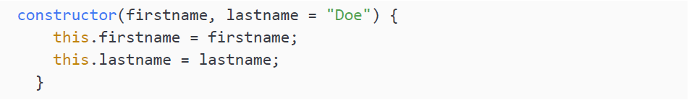
Constructors
You can specify default values in constructor. You would do it like this:
This way, it would not have printed Hi Maaike undefined, but Hi Maaike Doe.

Slide 14
Practice exercise 7.1
Take the following steps to create a person class, and print instances of friends’ names:
Create a class for Person including the constructor for firstname and lastname.
Create a variable and assign a value of the new Person object using your friend's first and last names.
Now add a second variable with another friend's name using their first name and last name.
Output both friends into the console with a greeting of hello.

Slide 15
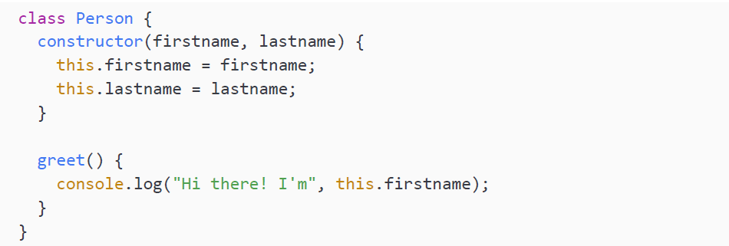
Methods
In a class, we can specify functions. This means that our object can start doing things using the object's own properties—for example, printing a name. Functions on a class are called methods. When defining these methods, we don't use the function keyword. We start directly with the name:

Slide 16
Methods
We can call the greet method on a Person object like this:
It will output:
You can specify as many methods on a class as you want. In this example, we are using the firstname property. We do so by saying this.property. If we had a person with a different value for the firstname property, for example, Rob, it would have printed:

Slide 17
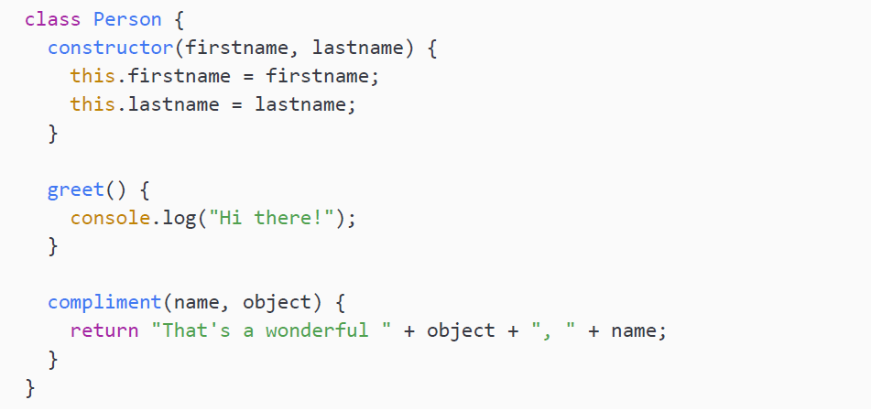
Methods
Just like functions, methods can also take parameters and return results:

Slide 18
Methods
The compliment function does not output anything itself, so we are logging it
The output will be:
In this case we are sending parameters into our method, because you don't usually compliment your own properties (that's a nice sentence, Maaike!). However, whenever the method doesn't require external input but only the properties of the object, no parameters will work and the method can use its object's properties. Let's do an exercise and then move on to using the properties of classes outside the class.

Slide 19
Practice exercise 7.2
Get your friend's full name:
Using the Person class from Practice exercise 7.1, add a method called fullname, which returns the concatenated value of firstname and lastname when invoked.
Create values for person1 and person2 using two friends' first and last names.
Using the fullname method within the class, return the full name of one or both people.

Slide 20
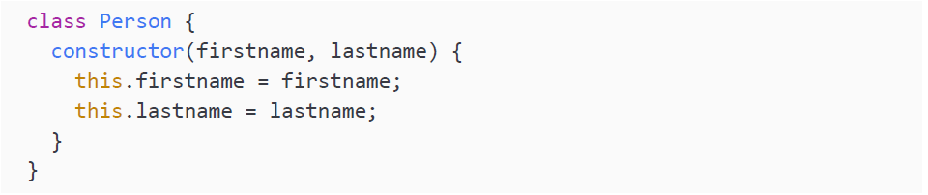
Properties
Properties, sometimes also called fields, hold the data of the class. We have seen one kind of property already, when we created them in our constructors:
Here, the Person class gets two properties from the constructor: firstname and lastname. Properties can be added or removed just like we did for objects. These properties can be accessed from outside the class, as we saw when we logged them outside the class by accessing them on the instance:

Slide 21
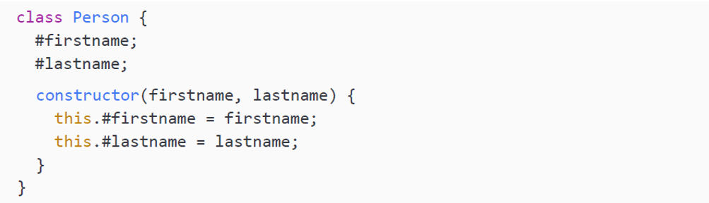
Properties
Often, it is not desirable to provide direct access to our properties. We want our class to be in control of the values of properties for several reasons—perhaps we want to do validation on a property to assure it has a certain value. For example, imagine wanting to validate an age as not being lower than 18. We can achieve this by making direct access to the property from outside the class impossible.
This is how to add properties that aren't accessible from outside. We prefix them with a # symbol:

Slide 22
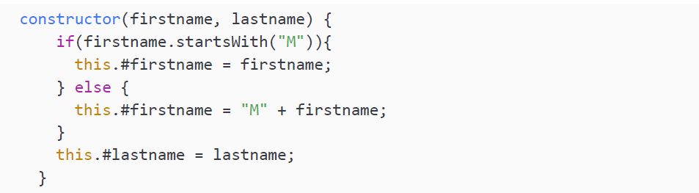
Properties
Right now, the firstname and lastname properties cannot be accessed from outside the class. This is done by adding # in front of the property. If we try it:
We'll get:
If we wanted to make sure we could only create objects with names starting with an "M," we could modify our constructor a bit

Slide 23
Properties
Now when you try to create a person that has a firstname value that doesn't start with an "M," it will add an M in front. So for example, the value of the following first name is Mkay:
This is a very silly example of validation. At this point, we cannot access it from outside the class at all after the constructor. We can only access it from inside the class. This is where getters and setters come into play.

Slide 24
Getters and setters
Getters and setters are special properties that we can use to get data from a class and to set data fields on the class. Getters and setters are computed properties. So, they are more like properties than they are like functions. We call them accessors. They do look a bit like functions, because they have () behind them, but they are not!
These accessors start with the get and set keywords. It is considered good practice to make fields private as much as possible and provide access to them using getters and setters. This way, the properties cannot be set from outside without the object itself being in control. This principle is called encapsulation. The class encapsulates the data, and the object is in control of its own fields.

Slide 25
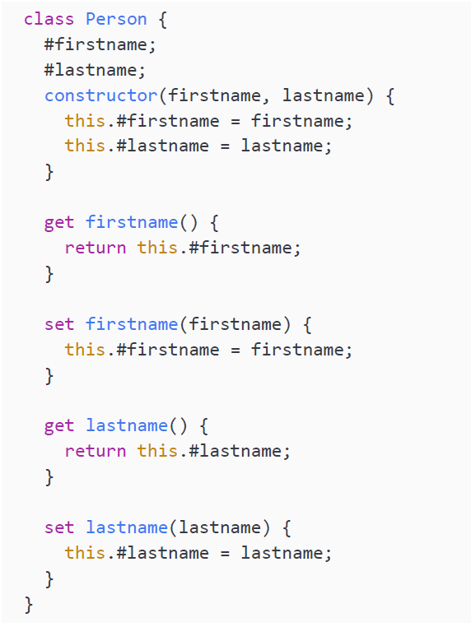
Getters and setters
Here is how to do it:

Slide 26
Getters and setters
The getter is used to get the property. Therefore, it doesn't take any parameters, but simply returns the property. The setter is the other way around: it takes a parameter, assigns this new value to the property, and returns nothing. The setter can contain more logic, for example, some validation, as we'll see below. The getter can be used outside the object as if it were a property. The properties are no longer directly accessible from outside the class, but can be accessed via the getter to get the value and via the setter to update the value. Here is how to use it outside the class instance:
This will output:

Slide 27
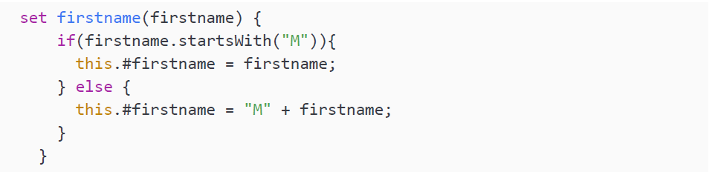
Getters and setters
We have created a new Person object with a first name of Maria and last name of Saga. The output is showing the first name, which is only possible because we have a getter accessor. We can also set the value to something else, because there is a setter.
Here is how to update the first name, so the name is no longer Maria, but Adnane.
At this point, nothing special is happening in the setter. We could do a similar validation as in the constructor before, like this:

Slide 28
Getters and setters
This will check whether firstname starts with an M, and if it does it will update the value to whatever the firstname parameter is. If it doesn't, it will concatenate an M in front of the parameter.
Please note that we do not access firstname as if it was a function. If you put two parentheses () after it, you would actually get an error telling you that it is not a function.

Slide 29
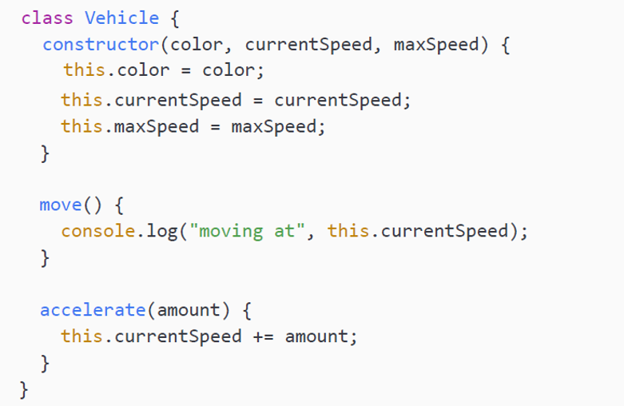
Inheritance
Inheritance is one of the key concepts of OOP. It is the concept that classes can have child classes that inherit the properties and methods from the parent class. For example, if you needed all sorts of vehicle objects in your application, you could specify a class named Vehicle in which you specify some shared properties and methods of vehicles. You would then go ahead and create the specific child classes based on this Vehicle class, for example, boat, car, bicycle, and motorcycle.
This could be a very simple version of the Vehicle class:

Slide 30
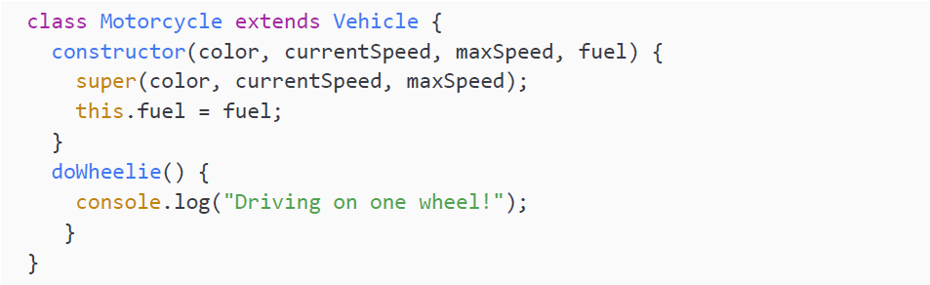
Inheritance
Here we have two methods in our Vehicle class: move and accelerate. And this could be a Motorcyle class inheriting from this class using the extends keyword:

Slide 31
Inheritance
With the extends keyword we specify that a certain class is the child of another class. In this case, Motorcycle is a child class of Vehicle. This means that we'll have access to properties and methods from Vehicle in our Motorcycle class. We have added a special doWheelie() method. This is not something that makes sense to add to the Vehicle class, because this is an action that is specific to certain vehicles.
The super word in the constructor is calling the constructor from the parent, the Vehicle constructor in this case. This makes sure that the fields from the parent are set as well and that the methods are available without having to do anything else: they are automatically inherited. Calling super() is not optional, you must do it when you are in a class that is inheriting from another class, else you will get a ReferenceError.

Slide 32
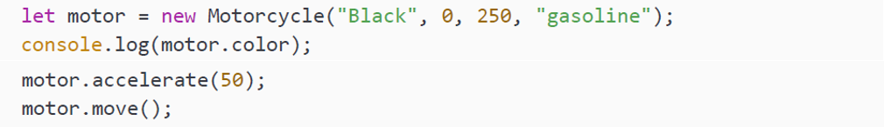
Inheritance
Because we have access to the fields of Vehicle in Motorcycle, this will work:
And this is what it will output:
We cannot access any Motorcycle specific properties or methods in our Vehicle class. This is because not all vehicles are motorcycles, so we cannot be sure that we would have the properties or methods from a child.
Right now, we don't use any getters and setters here, but we clearly could. If there are getters and setters in the parent class, they are inherited by the child class as well. This way we could influence which properties could be fetched and changed (and how) outside our class. This is generally a good practice.

Slide 33
Prototypes
A prototype is the mechanism in JavaScript that makes it possible to have objects. When nothing is specified when creating a class, the objects inherit from the Object.prototype prototype. This is a rather complex built-in JavaScript class that we can use. We don't need to look at how this is implemented in JavaScript, as we can consider it the base object that is always on top of the inheritance tree and therefore always present in our objects.
There is a prototype property available on all classes, and it is always named "prototype." We can access it like this:

Slide 34
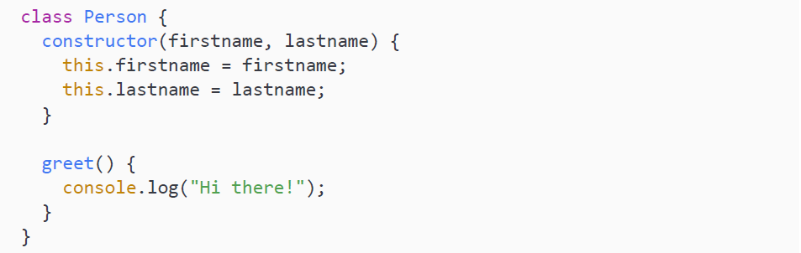
Prototypes
Let's give an example of how to add a function to a class using the prototype property. In order to do so, we'll be using this Person class:

Slide 35
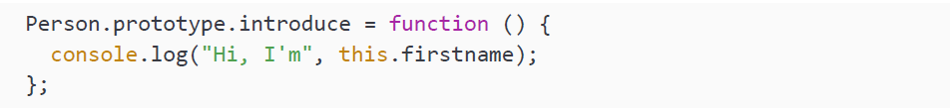
Prototypes
And here is how to add a function to this class using prototype:
prototype is a property holding all the properties and methods of an object. So, adding a function to prototype is adding a function to the class. You can use prototype to add properties or methods to an object, like we did in the above example in our code with the introduce function. You can also do this for properties:

Slide 36
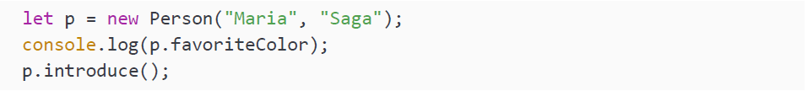
Prototypes
And then you can call them from instances of Person:
It will output:
And it will be as if you had defined the class with a favorite color holding a default value, and a function, introduce. They have been added to the class and are available for all instances and future instances.

Slide 37
Prototypes
So the methods and properties defined via prototype are really as if they were defined in the class. This means that overwriting them for a certain instance doesn’t overwrite them for all instances. For example, if we were to have a second Person object, this person could overwrite the favoriteColor value and this wouldn’t change the value for our object with firstname as Maria.
This is something you should not be using when you have control over the class code and you want to change it permanently. In that case, just change the class. However, you can expand existing objects like this and even expand existing objects conditionally. It is also important to know that the JavaScript built-in objects have prototypes and inherit from Object.prototype. However, be sure not to modify this prototype since it will affect how our JavaScript works.

Slide 38
Practice exercise 7.3
Create a class that contains properties for different animal species and the sound that each species makes, and create two (or more) animals:
Create a method that prints a given animal and its sound.
Add a prototype with another action for the animal.
Output an entire animal object into the console.

Slide 39
Employee tracking app
Create a class to track the employees of a company:
Use first names, last names, and the number of years worked as values in the constructor.
Create two or more people with values for their first names, last names, and the number of years they've worked at the company. Add the people into an array.
Set up a prototype to return the details of the person's first and last names and how long they've worked at the company.
Iterate the contents of the array to output the results into the console, adding some text to make the output a full sentence.

Slide 40
Menu items price calculator
Create a class which will allow you to work out the combined price of a number of items, and interact with it to work out the total cost of different orders.
Create a class that contains the prices of two menu items as private field declarations.
Use the constructor in the class to get the argument values (how many of each item are being bought).
Create a method to calculate and return the total cost depending on how many of each item the user selects.
Use a getter property to grab the value output by the calculation method.
Create two or three objects with different combinations of menu selections, and output the total cost in the console.

Slide 41
Self-check quiz
What is the keyword used to create a class?
How would you set up a class for a person's first and last names that could include first and last as initial properties?
What is the concept of one thing gaining the properties and behaviors of another thing called?
Which of the following are true about the constructor method?
It gets executed automatically when a new object is created.
It should only be added afterward.
It has to include the constructor keyword.
It is used to initialize object properties.
It can be used when you have multiple values.

Slide 42
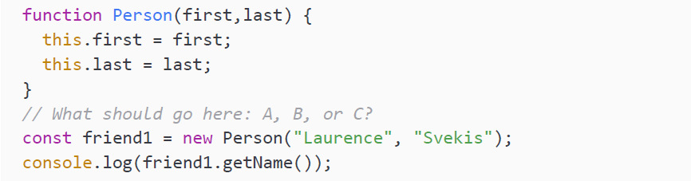
Self-check quiz
Troubleshoot the following code so that the prototype outputs the first and last name of the Person into the console. Which is the correct syntax for the Person prototype?

Slide 43
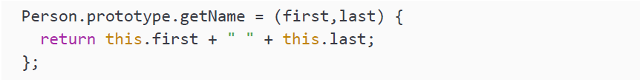
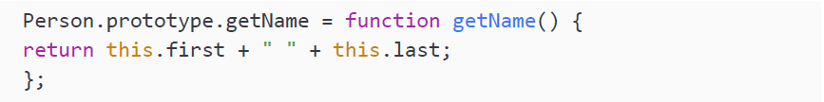
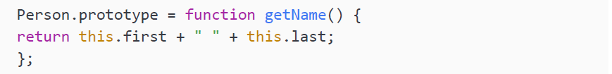
Self-check quiz

Slide 44
Summary
In this chapter, we introduced you to the concept of OOP. This means that we structure our code in such a way that objects are the central players of the logic. Classes are blueprints for objects. We can make a template for an object and create an instance easily by using the new keyword.
We then saw that classes can inherit from each other by using the extends keyword. Classes that extend from another class will have to call the constructor of this class with super() and will then automatically have access to all the properties and methods of the parent. This is great for reusable and highly maintainable code.
Lastly, we encountered prototypes. This is the built-in JavaScript concept that makes classes possible. By adding properties and methods to a class using prototype, we can modify the blueprint of that class.
In the next chapter, we will consider some of JavaScript's built-in methods, which can be used to manipulate and add complexity to your code!

